Slide 1

Basics of Neuroscience for BCI
BCI-S2022

Slide 2
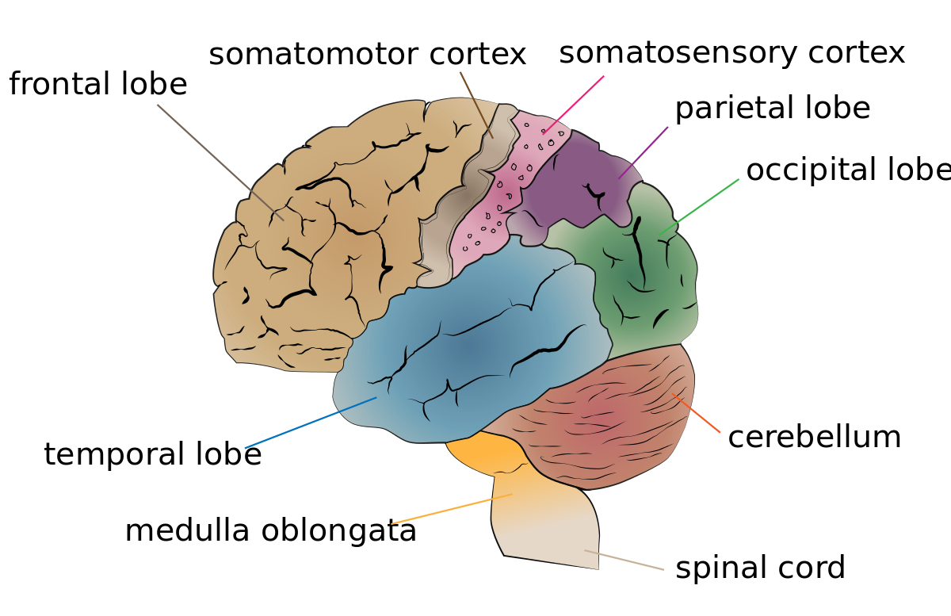
The Human Brain
Notes:
Weighing in at about three pounds, the human brain is a marvel of evolutionary engineering. The brain transforms signals from millions of sensors located all over the body into appropriate muscle commands to enact a behavior suitable to the task at hand.

Slide 3
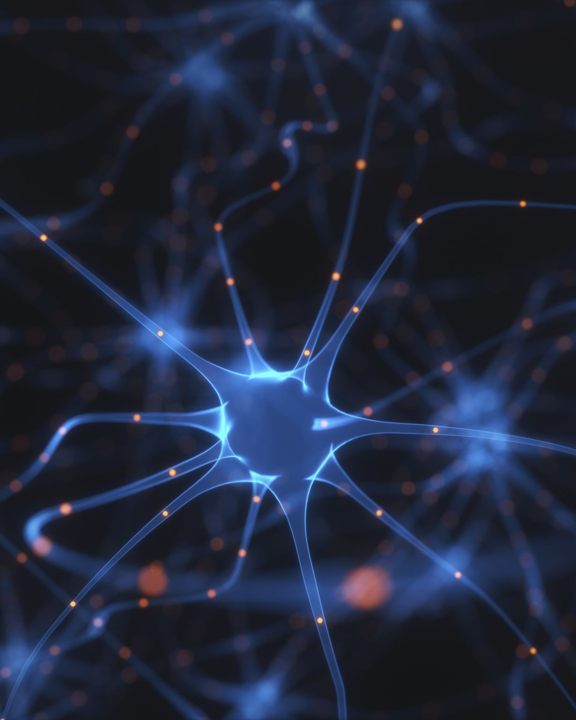
The Neuron
The brain’s unique information processing capabilities arise from its massively parallel and distributed way of computing.
The workhorse of the brain is a type of cell known as a NEURON.
Neuron is a complex electrochemical device that receives information from hundreds of other neurons, processes this information, and conveys its output to hundreds of other neurons
Notes:
The connections between neurons are plastic, allowing the brain’s networks to adapt to new inputs and changing circumstances

Slide 4
The Neuron
The neuron can be regarded as a leaky bag of charged liquid.
The membrane of a neuron is made up of a lipid bi-layer that is impermeable except for openings called ionic channel.
The ionic channels selectively allow the passage of a few ions
Notes:
The connections between neurons are plastic, allowing the brain’s networks to adapt to new inputs and changing circumstances

Slide 5
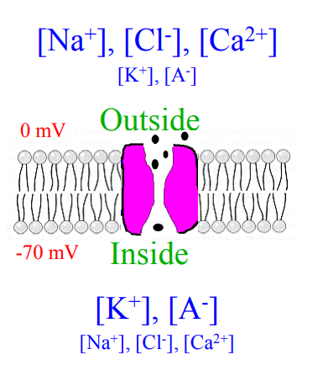
The Electrical Personality of a Neuron
Each neuron maintains a potential difference across its membrane
Inside is ±70 to ±80 mV relative to outside
[Na+], [Cl- ] and [Ca2+] higher outside; [K+] and organic anions [A- ] higher inside
Ionic pump maintains -70 mV difference by expelling Na+ out and allowing K+ ions in

Slide 6
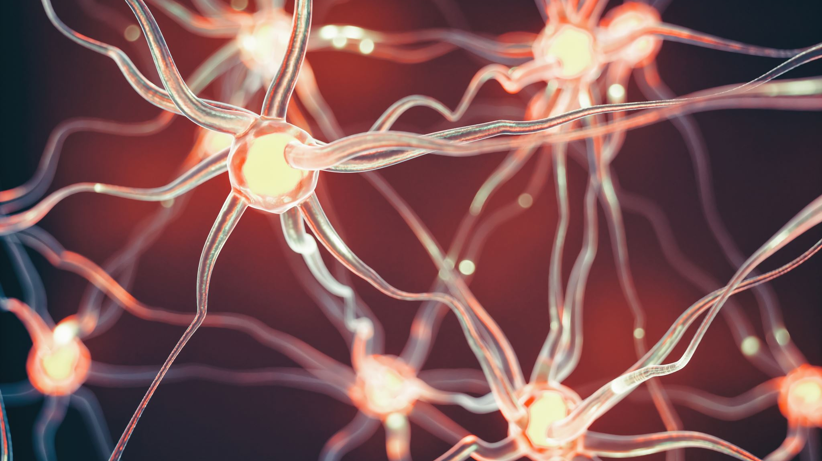
How can the electrical potential be changed in local regions of a neuron?

Slide 7
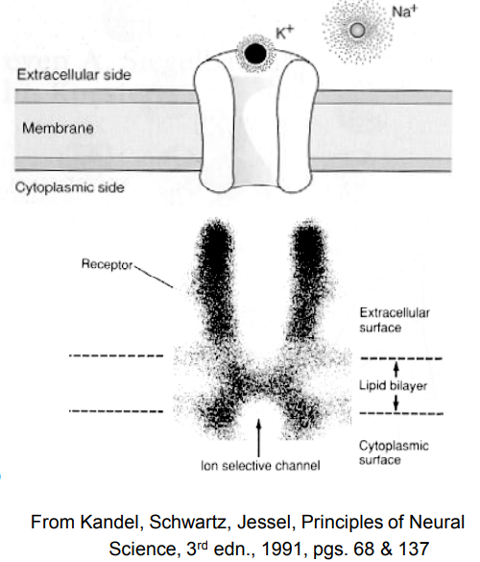
Ionic Channels: The Gatekeepers
Proteins in membranes act as channels that allow specific ions to pass through.
E.g.: Pass K+ but not Cl- or Na+
These IONIC CHANNELS are gated
Voltage-gated: Probability of opening depends on membrane voltage
Chemically-gated: Binding to a chemical causes channel to open
Mechanically-gated: Sensitive to pressure or stretch

Slide 8
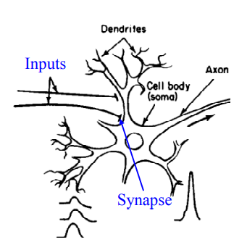
Gated Channels allow Neuronal Signaling
Inputs from other neurons -> chemically-gated channels (at “synapses”) -> Changes in local membrane potential
This causes opening/closing of voltage-gated channels in dendrites, body, and axon, resulting in depolarization (positive change in voltage) or hyperpolarization (negative change)

Slide 9
Regions of Neurons
Neurons in different regions of the brain have different morphological structures
The typical structure includes a cell body (called the soma) connected to a tree-like structure with branches called dendrites
A single branch called the axon that emanates from the soma and conveys the output spike to other neurons.
The spike is typically initiated near the junction of the soma and axon and propagates down the length of the axon.
Many axons are covered by myelin, a white sheath that significantly boosts the speed of propagation of the spike over long distances.

Slide 10
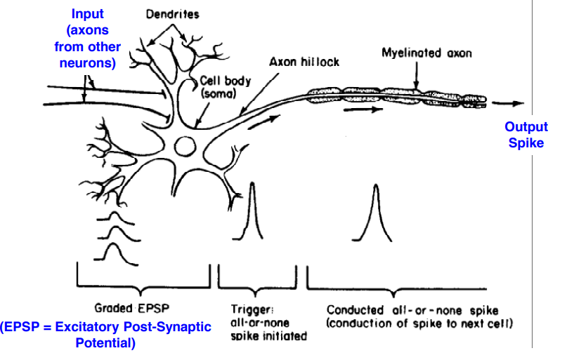

Slide 11
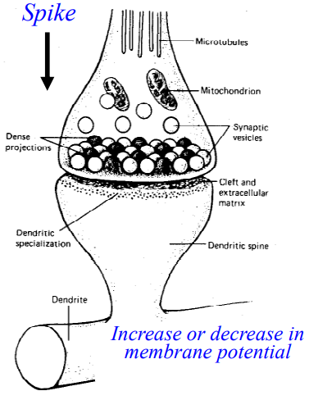
Synapse
Neurons communicate with each other through connections known as synapses.
Synapses can be electrical but are more typically chemical.
A synapse is essentially a gap or cleft between the axon of one neuron (called the presynaptic neuron) and a dendrite (or soma) of another neuron (called the postsynaptic neuron)

Slide 12
Synapse
When an action potential arrives from a presynaptic neuron, it causes the release of chemicals known as neurotransmitters into the synaptic cleft.
These chemicals in turn bind to the ionic channels (or receptors) on the postsynaptic neuron, causing these channels to open, thereby influencing the local membrane potential of the postsynaptic cell.

Slide 13
Synapse
Synapses can be excitatory or inhibitory.
Excitatory synapses cause a momentary increase in the local membrane potential of the postsynaptic cell.
This increase is called an excitatory postsynaptic potential (EPSP).
EPSPs contribute to a higher probability of firing a spike by the postsynaptic cell.
Inhibitory synapses do the opposite, temporarily decrease the local membrane potential of the postsynaptic cell
They cause inhibitory postsynaptic potentials (IPSPs)
A neuron is called excitatory or inhibitory based on the kind of synapse it forms with postsynaptic neurons

Slide 14
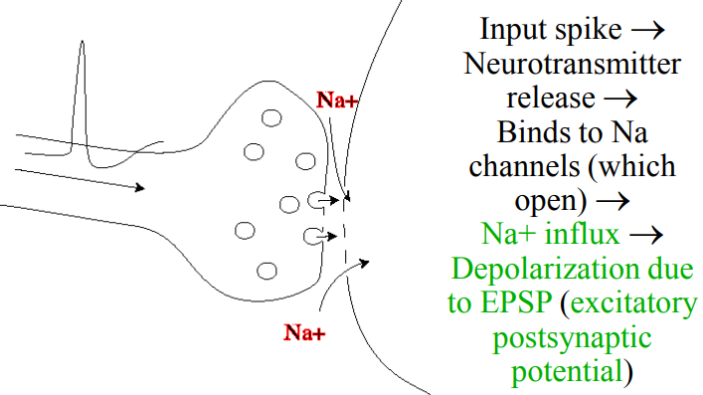
An Excitatory Synapse

Slide 15
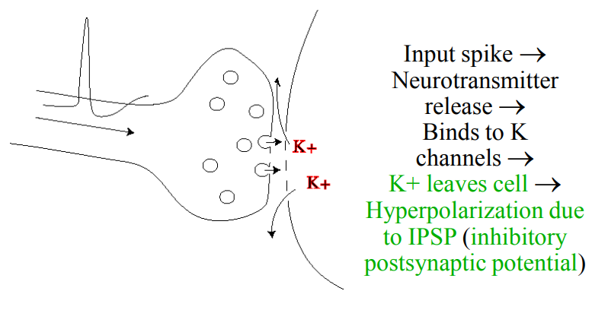
An Inhibitory Synapse

Slide 16
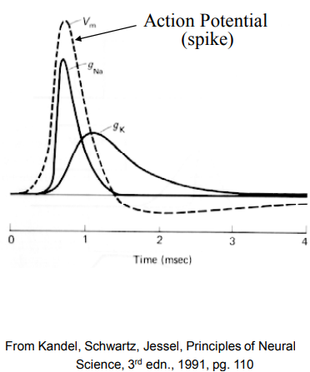
Action Potential or Spikes
When the neuron receives sufficiently strong inputs from other neurons a cascade of events is triggered
Rapid influx of Na+ ions into the cell
Causing the membrane potential to rise rapidly.
The opening of K+ channels triggers the outflux of K+ ions
Causing a drop in the membrane potential.
This rapid rise and fall of the membrane potential is called an action potential or spike and represents the dominant mode of communication between one neuron and another.

Slide 17
Spike Generation
The generation of a spike by a neuron involves a complex cascade of events involving sodium and potassium channels
This process can be simplified into a simple threshold model of spike generation.
When the neuron receives sufficiently strong inputs from its synapses for its membrane potential to cross a neuron-specific threshold, a spike is emitted.
Notes:
This makes the neuron a hybrid analog-digital computing device: digital 0/1 inputs are converted to analog changes in the local membrane potential, followed by summation of these changes at the soma, and a spike if the summation of changes exceeds threshold. This simplified model of course ignores the complex and potentially important forms of signal processing associated with dendrites, but the threshold model of a neuron has proven to be a useful abstraction in neural modeling and artificial neural networks.

Slide 18
Synaptic plasticity: Adapting the connections
Long Term Potentiation (LTP): Increase in synaptic strength of a synaptic connection between two neurons caused by correlated firing of the two neurons
lasts for several hours or more.
Measured as an increase in the excitatory postsynaptic potential (EPSP) caused by presynaptic spikes
LTP has been found in several brain areas including the hippocampus and the neocortex.
Note: LTP is regarded as a biological implementation of Donald Hebb’s famous postulate (also called Hebbian learning or Hebbian plasticity) that if a neuron A is consistently involved in causing another neuron B to fire, then the strength of the connection from A to B should be increased.
Notes:
A critical component of the brain’s adaptive capabilities is the ability of neurons to change the strength of the connections between themselves through synaptic plasticity

Slide 19
Synaptic plasticity: Adapting the connections
Long-term depression or LTD: Decrease in the strength of a synaptic connection caused
by uncorrelated firing between the two neurons involved.
Reduction in synaptic strength that lasts for several hours or more
LTD has been observed most prominently in the cerebellum, although it also coexists with LTP in the hippocampus, neocortex, and other brain areas

Slide 20
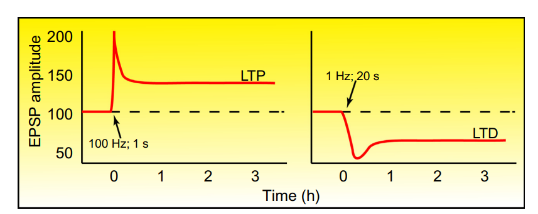
Synaptic plasticity: Adapting the connections
Figure: Long-term potentiation (LTP) and long-term depression (LTD).
Plots of excitatory postsynaptic potential amplitude at a hippocampal synapse over time during two different stimulus patterns. (Left panel) Following a long burst of high-frequency stimulation (100 Hz for 1 s), synapses strengthen, leading to a larger EPSP amplitude, and this is maintained for hours (LTP). The transient spike in strengthening that occurs immediately after the 100 Hz stimulus train results from post-tetanic potentiation. (Right panel) Following a low-frequency train of activity (1 Hz for 20 s), synapses weaken persistently, leading to a smaller EPSP amplitude (LTD).
Image from: Meriney, Stephen D. (2019). Synaptic Transmission || Synaptic Plasticity. , (), 287–329.

Slide 21
Synaptic plasticity: Adapting the connections
Spike timing dependent plasticity (STDP):
The relative timing of input and output spikes determines the polarity of synaptic change.
The timing between presynaptic and postsynaptic spikes
Can determine whether the change in synaptic strength is positive or negative
Hebbian STDP: If the presynaptic spike occurs slightly before the postsynaptic spike (e.g., 1–40 ms before), the synapse is strengthened, whereas if the presynaptic spike occurs slightly after (e.g., 1–40 ms after), the synaptic strength is decreased.

Slide 22
Synaptic plasticity: Adapting the connections
Short-term facilitation/depression
The plasticity is rapid but not long-lasting.
Short-term depression: The effect of each successive spike in an input spike train (sequence of spikes) is diminished compared to the preceding spike.
Short-term facilitation: The effect of each successive spike has a larger effect than its predecessor, until a saturation point is reached

Slide 23
Brain Organization, Anatomy, and Function
The design of a brain-computer interface typically involves choices regarding which brain areas to record from and, in some cases, which brain areas to stimulate.
The human nervous system can be broadly divided into
The central nervous system (CNS).
The CNS consists of the brain and the spinal cord.
The peripheral nervous system (PNS).
The PNS consists of the somatic nervous system (neurons connected to skeletal muscles, skin, and sense organs) and the autonomic nervous system (neurons that control visceral functions such as the pumping of the heart, breathing, etc.).
Notes:
The spinal cord is the main pathway that conveys descending motor-control signals from the brain to muscles all over the body and ascending sensory feedback information from the muscles and skin back to the brain.

Slide 24
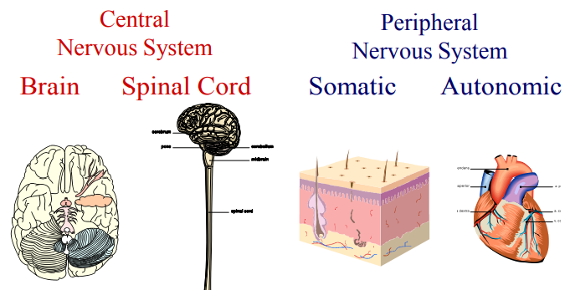
Brain Organization, Anatomy, and Function

Slide 25
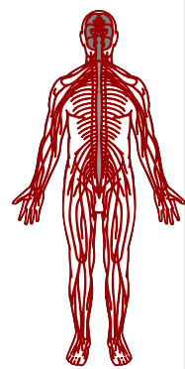
Skeletal/Somatic Nervous System
Nerves that connect to voluntary skeletal muscles and to sensory receptors
Afferent Nerve Fibers (incoming)
Axons that carry info away from the periphery to the CNS
Efferent Nerve Fibers (outgoing)
Axons that carry info from the CNS outward to the periphery

Slide 26
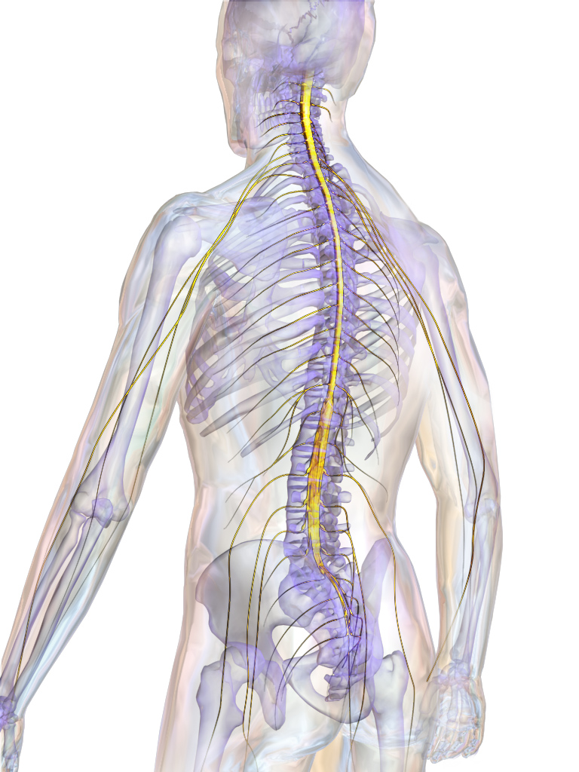
Autonomic and Central Nervous System
Autonomic: Nerves that connect to the heart, blood vessels, smooth muscles, and glands
CNS = Brain + Spinal Cord
Spinal Cord
Local feedback loops control reflexes
Descending motor control signals from the brain activate spinal motor neurons
Ascending sensory axons transmit sensory feedback information from muscles and skin back to brain
This Photo by Unknown Author is licensed under CC BY

Slide 27
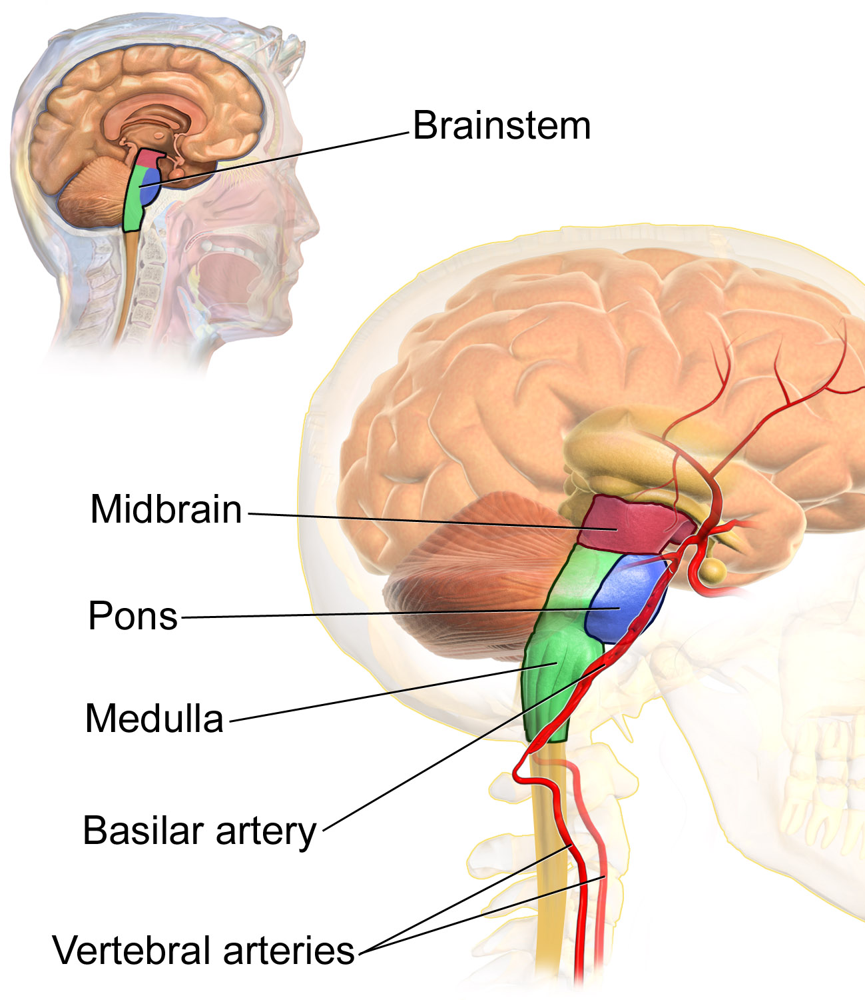
Major Brain Regions: Brain Stem
Medulla: Breathing, muscle tone and blood pressure
Pons: Connects brainstem with cerebellum & involved in sleep and arousal
Cerebellum: Coordination of voluntary movements and sense of equilibrium
Midbrain: Eye movements, visual and auditory reflexes
Cerebellum

Slide 28
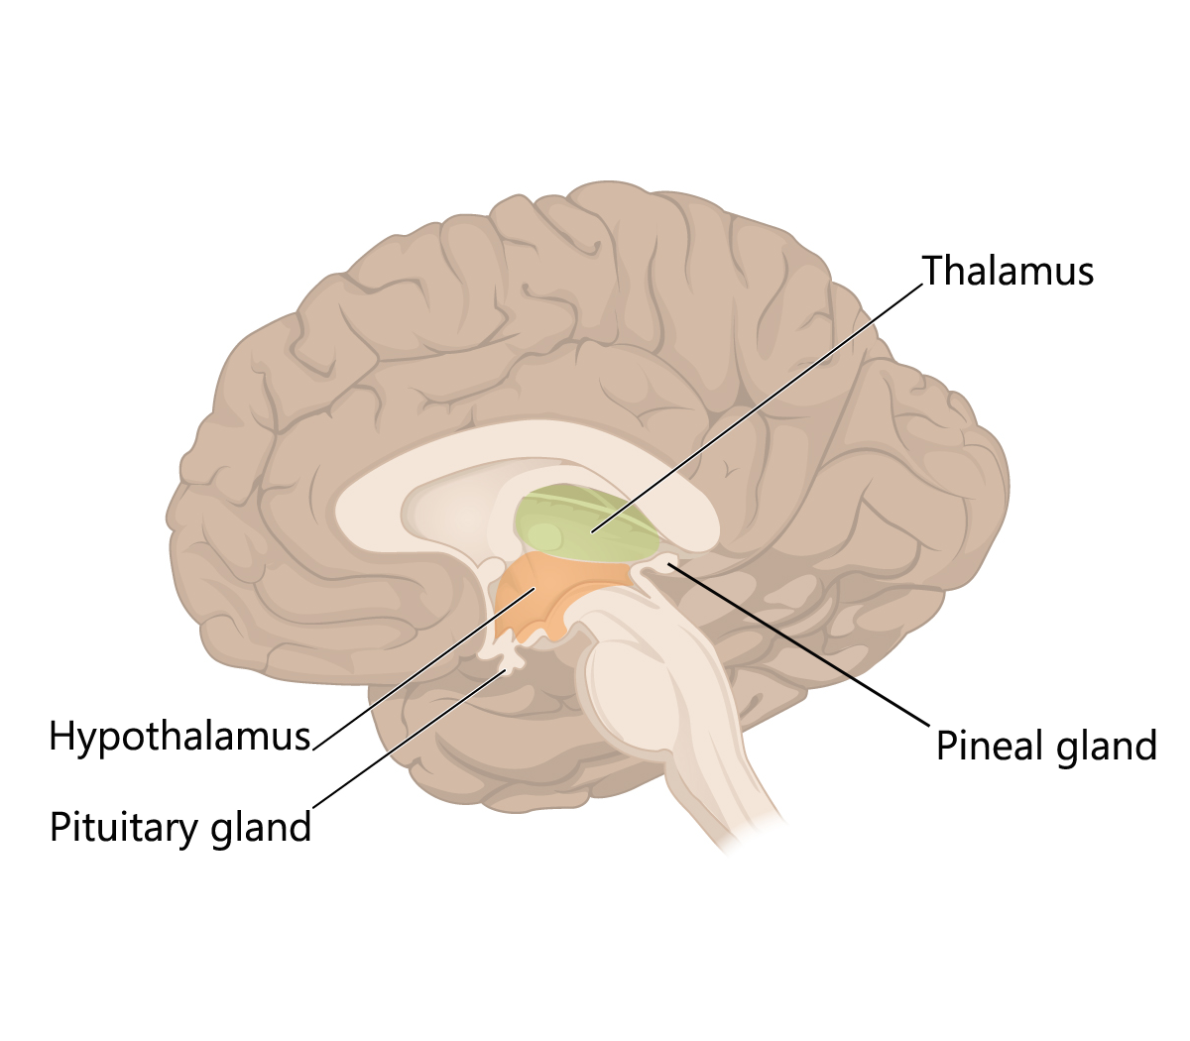
Major Brain Regions: Diencephalon
Thalamus: Relay station for all sensory info (except smell) to the cortex
Hypothalamus Regulates basic needs fighting, fleeing, feeding, and mating
This Photo by Unknown Author is licensed under CC BY-SA

Slide 29
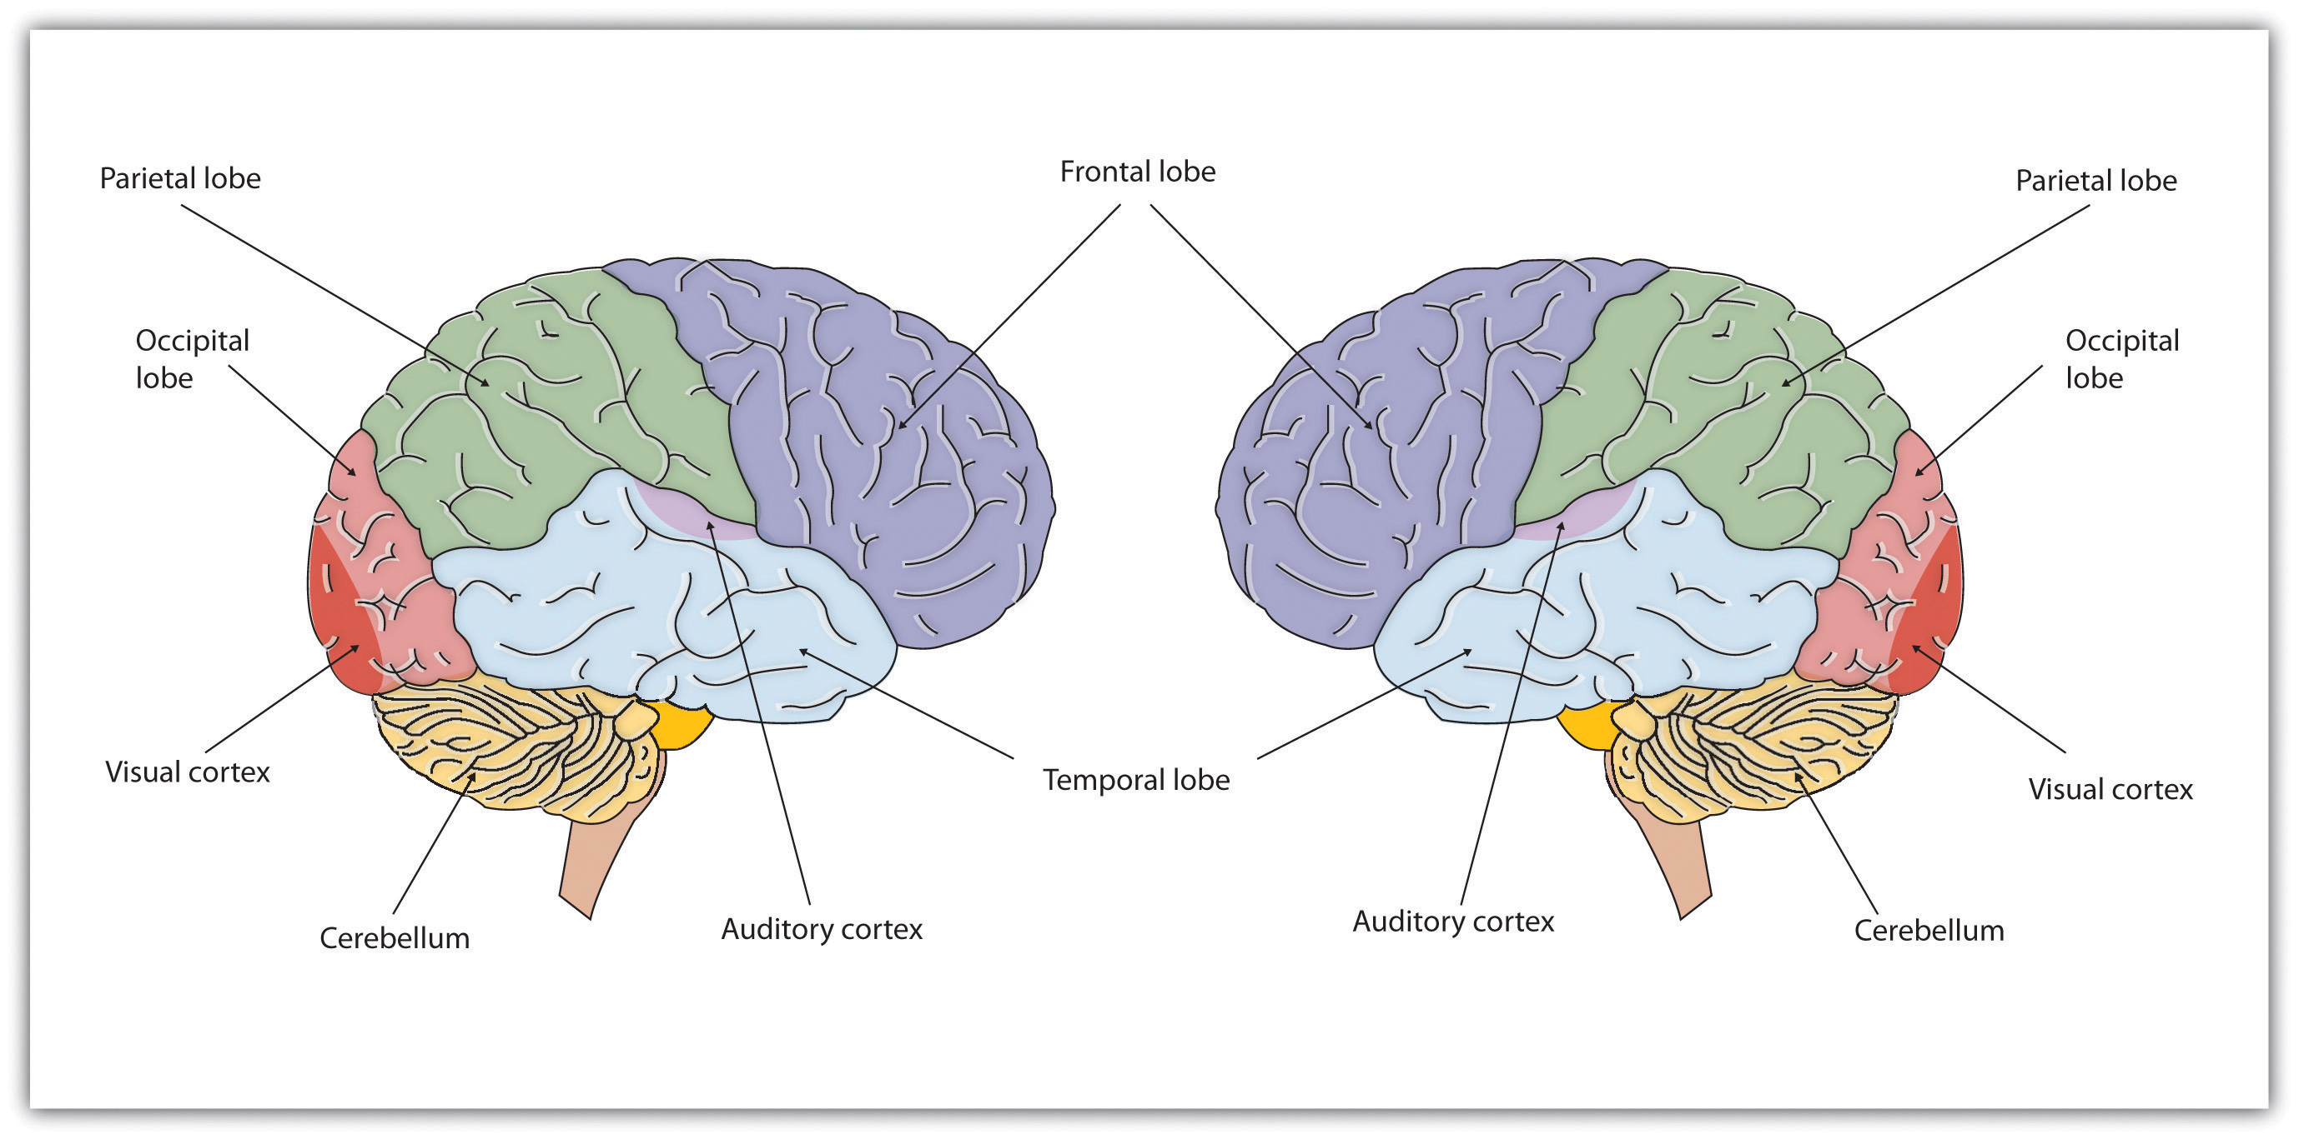
Major Brain Regions: Cerebral Hemispheres
Consists of Cerebral cortex, basal ganglia, hippocampus, and amygdala
Involved in perception and motor control, cognitive functions, emotion, memory, and learning
This Photo by Unknown Author is licensed under CC BY-NC

Slide 30
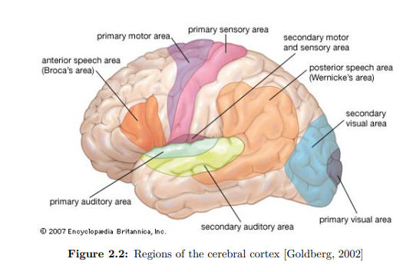

Slide 31
